Slide 1
- common
- uncommon
- rare
- epic
- legendary

Slide 2
staff

Slide 3
laser blaster

Slide 4










laser blaster

Slide 5
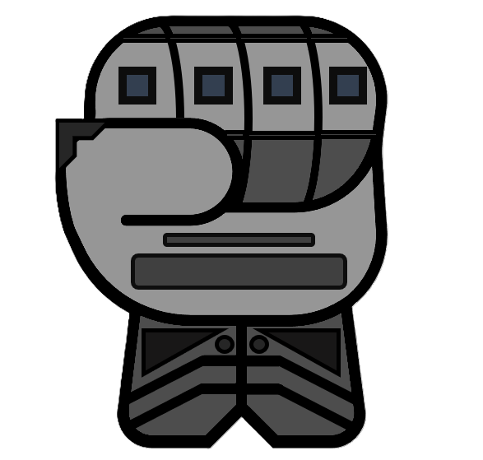
gloves

Slide 6
sticky grenade

Slide 7
smoke grenade

Slide 8
blast grenade

Slide 9



molly grenade

Slide 10
magnetic grenade

Slide 11
Small heal vial

Slide 12
Speed Boost Battery

Slide 13
Electric baton

Slide 14
Detonator mine

Slide 15
Metallic Whip

Slide 16
Daggers

Slide 17
Passive health regen vial

Slide 18
Force push bracelet

Slide 19
Light Shield Barrier

Slide 20
Warhammer

Slide 21
Deployable Barrier Wall

Slide 22
Grapple Hook

Slide 23
Beam Sword

Slide 24
Double Pistol Blasters

Slide 25
burst grenade

Slide 26
ice grenade

Slide 27
flash grenade

Slide 28
distract grenade

Slide 29
Bigger speed boost battery

Slide 30
Medium passive health regen vial

Slide 31
Medium Shield Barrier

Slide 32
Turret

Slide 33
Wave Ray Gun

Slide 34
Freeze Gun

Slide 35
Flamethrower

Slide 36
Heal Dispenser Farm

Slide 37
Hand Cannon

Slide 38
Large passive health regen vial

Slide 39
Teleportation Bracelet

Slide 40
Temporary Invincible Battery

Slide 41
Heavy Shield Barrier

Slide 42
Large Warhammer

Slide 43
Throwable Beam Sword

Slide 44
Advanced Turret

Slide 45
Hoverboard

Slide 46
Assault Rifle Blaster

Slide 47
Sniper Rifle Blaster

Slide 48
Double Lightsabers

Slide 49
Void Grenade Launcher

Slide 50
Sidekick Robot

Slide 51
Reflect Shield

Slide 52
Stim Shot

Slide 53
Dennis

